Slide 1
Web Programming 06016322
By Dr Bundit Thanasopon

Slide 2
How the web works
Src: https://developer.Mozilla.Org/en-us/docs/learn/getting_started_with_the_web/how_the_web_works

Slide 3
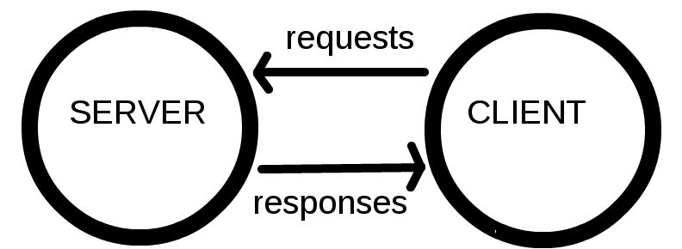
Clients and servers
Computers connected to the web are called clients and servers. A simplified diagram of how they interact might look like this:
Clients are the typical web user's internet-connected devices.
Servers are computers that store webpages, sites, or apps.

Slide 4
Other important components
Your internet connection: Allows you to send and receive data on the web.
TCP/IP: Transmission Control Protocol and Internet Protocol are communication protocols that define how data should travel across the web.
DNS: Domain Name Servers are like an address book for websites.
HTTP: Hypertext Transfer Protocol is an application protocol that defines a language for clients and servers to speak to each other.
Component files: A website is made up of many different files.
Code files - HTML, CSS, and JavaScript
Assets - images, music, video, Word documents, and PDFs
Notes:
Example -> Go shopping
Your internet connection = Street
TCP/IP = Car or bike (transport mechanisms)
DNS = Yellow pages
HTTP = speaking language
Components file = products that you want to buy

Slide 5
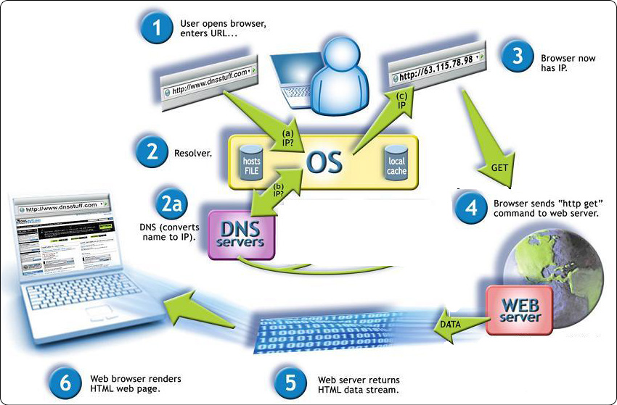
Domain name servers - DNS
Src: http://www.gargasz.info/how-internet-works-dns/
Notes:
ยกตัวอบ่า

Slide 6
Overview of HTTP

Slide 7
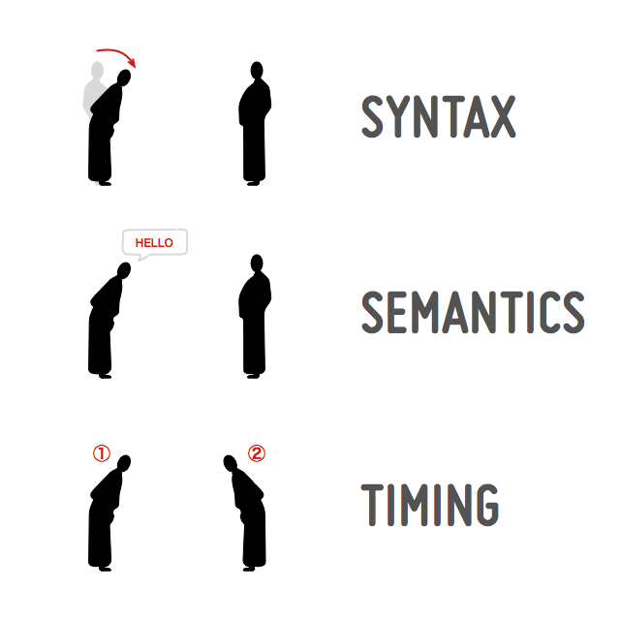
What is a communication protocol?
To be able to communicate, two parties (be they software, devices, people, etc.) need:
Syntax
Semantics
Timing
Notes:
When two people meet, they engage using a communication protocol: for example, in Japan, a person will make a specific gesture with the body. One such gesture is a bow, which is the syntax used for the interaction. In Japanese customs, the gesture of the bow (among others) is associated with the semantics of greeting someone. Finally, when one person bows to another person, a sequence of events has been established between the two in a specific timing.
An online communication protocol contains the same elements.
The syntax will be the sequence of characters such as keywords we use for writing the protocols.
The semantics is the meaning associated with each of these keywords.
The timing is the order in which two or more entities exchange these keywords.
https://dev.opera.com/articles/http-basic-introduction/

Slide 8
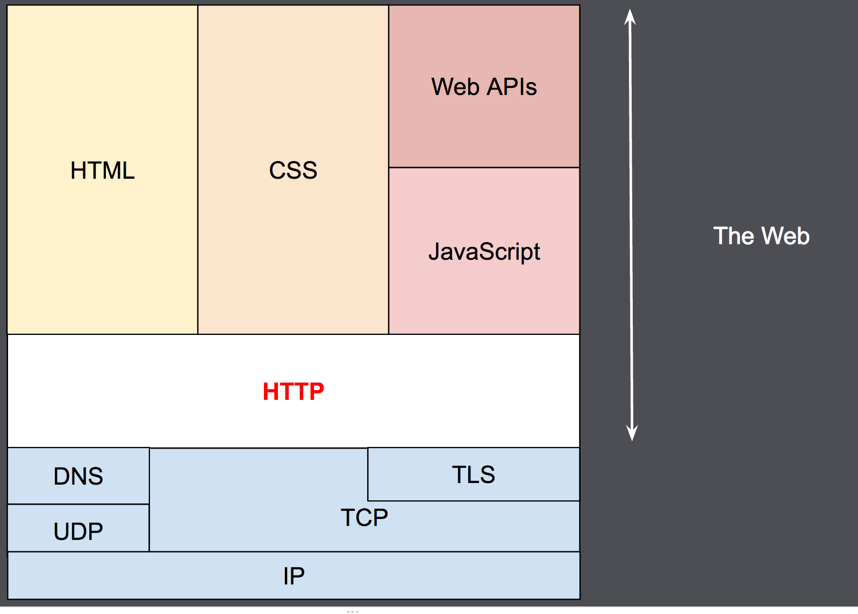
HTTP
HTTP is a protocol which allows the fetching of resources, such as HTML documents. It is the foundation of any data exchange on the Web and a client-server protocol.
It is an application layer protocol that is sent over TCP, or over a TLS-encrypted TCP connection

Slide 9
Components of HTTP-based systems
HTTP is a client-server protocol: requests are sent by one entity, the user-agent -> a Web browser
Each individual request is sent to a server, which will handle it and provide an answer, called the response.

Slide 10
Client: the user-agent
The user-agent is any tool that acts on the behalf of the user.
The browser is always the entity initiating the HTTP request. It is never the server (though some mechanisms have been added over the years to simulate server-initiated messages).
To present a Web page, the browser sends an original request to fetch the HTML document from the page.
It then parses this file, fetching additional requests corresponding to execution scripts, layout information (CSS) to display, and sub-resources contained within the page (usually images and videos).
The Web browser then mixes these resources to present to the user a complete document, the Web page.

Slide 11
The Web server
On the opposite side of the communication channel, is the server which serves the document as requested by the client.
A server presents only as a single machine virtually: this is because it may actually be a collection of servers:
Load balancers
Database servers
E-commerce servers

Slide 12
Basic aspects of HTTP
HTTP is simple - HTTP messages can be read and understood by humans, providing easier developer testing, and reduced complexity for new-comers.
HTTP is stateless, but not sessionless - HTTP is stateless: there is no link between two requests being successively carried out on the same connection. If so:
How shopping basket on e-commerce websites work?
How websites maintain logged-in states?
HTTP Cookies allow session creation on each HTTP request to share the same context, or the same state.

Slide 13
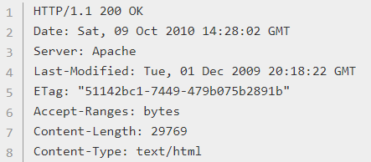

HTTP flow
When the client wants to communicate with a server, either being the final server or an intermediate proxy, it performs the following steps:
Open a TCP connection
Send an HTTP message
Read the response sent by the server
Close or reuse the connection for further requests.
Notes:
https://developer.mozilla.org/en-US/docs/Web/HTTP/Overview

Slide 14
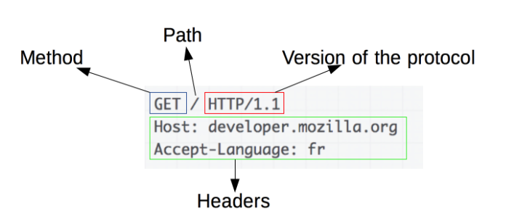
HTTP Messages
HTTP/1.1 and earlier HTTP messages are human-readable. In HTTP/2, these messages are embedded into a new binary structure, a frame, allowing optimizations like compression of headers and multiplexing.
There are two types of HTTP messages, requests and responses, each with its own format.
An example HTTP request:
Notes:
https://developer.mozilla.org/en-US/docs/Web/HTTP/Headers

Slide 15
HTTP Requests
Requests consists of the following elements:
An HTTP method, usually a verb like GET, POST or a noun like OPTIONS or HEAD that defines the operation the client wants to perform.
Typically, a client wants to fetch a resource (using GET) or post the value of an HTML form (using POST), though more operations may be needed in other cases.
The path of the resource to fetch; the URL of the resource stripped from elements that are obvious from the context.
The version of the HTTP protocol.
Optional headers that convey additional information for the servers.
Or a body, for some methods like POST, similar to those in responses, which contain the resource sent.

Slide 16
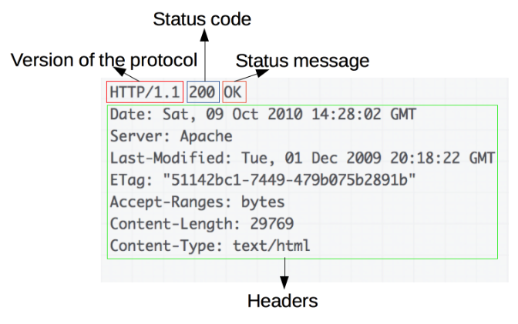
HTTP Responses
An example response:

Slide 17
HTTP Responses
Responses consist of the following elements:
The version of the HTTP protocol they follow.
A status code, indicating if the request has been successful, or not, and why.
A status message, a non-authoritative short description of the status code.
HTTP headers, like those for requests.
Optionally, a body containing the fetched resource.

Slide 18
MVC Concepts
Src: https://developer.Mozilla.Org/en-us/docs/web/apps/fundamentals/modern_web_app_architecture/mvc_architecture

Slide 19
The theory behind Model View Controller (MVC)
Model View Controller (MVC) is a software architecture pattern, commonly used to implement user interfaces: it is therefore a popular choice for architecting web apps.
In general, it separates out the application logic into three separate parts
Model: model represents the data
View: view is the user interface
Controller: controller handles the user request

Slide 20
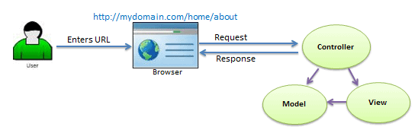
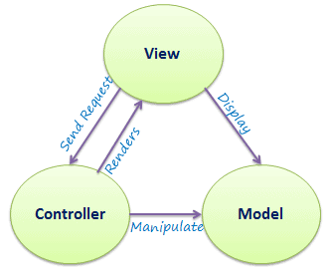

Slide 21
MVC Components
Model: Model code typically reflects real-world things. This code can hold raw data, or it will define the essential components of your app.
For instance, if you were building a To-do app, the model code would define what a “task” is and what a “list” is
View: View code is made up of all the functions that directly interact with the user. This is the code that makes your app look nice, and otherwise defines how your user sees and interacts with it.
Controller: Controller code acts as a liaison between the Model and the View, receiving user input and deciding what to do with it. It’s the brains of the application, and ties together the model and the view.

Slide 22
An Analogy - Cooking
Model
Controller
View
Notes:
s kind of like how you make a dinner. You have a fridge full of food, which is like the Model.
The fridge (Model) contains the raw materials we will use to make dinner.
You also probably have a recipe or two. A recipe (assuming you follow it exactly) is like the Controller of the dinner. Recipes dictate which stuff in the fridge you’ll take out, how you’ll put it together, and how long you need to cook it.
Then, you have table-settings, silverware, etc., which are what your hungry friends and family use to eat dinner. Table-top items are like the View.
They let your guests interact with your Model and Controller’s creation.

Slide 23
REST API
https://www.infoworld.com/article/3269878/what-is-an-api-application-programming-interfaces-explained.html

Slide 24
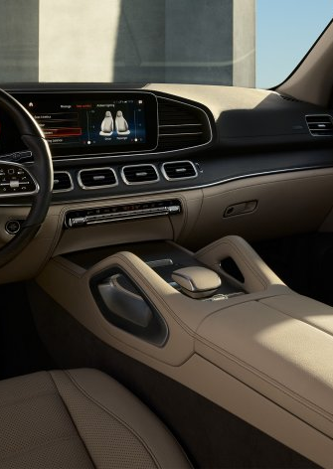
What are APIs?
API stands for application programming interface, a concept that applies everywhere from command-line tools to enterprise Java code to Ruby on Rails web apps.
An API is a way to programmatically interact with a separate software component or resource.
Imagine that a car was a software component.
Its API would include information about what it can do—accelerate, brake, turn on the radio, etc.
It would also include information about how you could make it do those things. For instance, to accelerate, you put your foot on the gas pedal and push.
Notes:
The API doesn’t have to explain what happens inside the engine when you put your foot on the accelerator.
That’s why, if you learned to drive a car with an internal combustion engine, you can get behind the wheel of an electric car without having to learn a whole new set of skills.
The what and how information come together in the API definition, which is abstract and separate from the car itself.

Slide 25
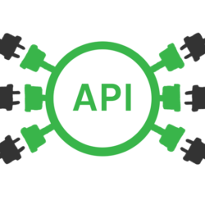
Public APIs and API integration
APIs are a longstanding concept in computer programming, and they have been part of developers’ toolsets for years.
Traditionally, APIs were used to connect code components running on the same machine. With the rise of ubiquitous networking, more and more public APIs, sometimes called open APIs, have become available.
Public APIs are outward facing and accessible over the Internet, allowing you to write code that interacts with other vendors’ code online; this process is known as API integration.

Slide 26
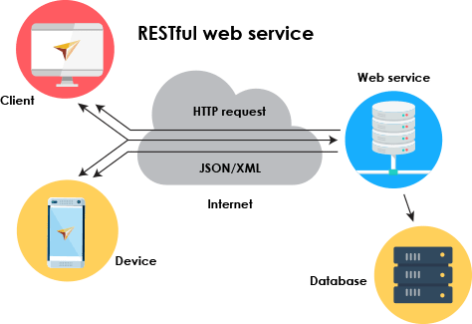
Web services and APIs
You might have heard the term “web services” and think that the idea of an open API sounds pretty similar.
In fact, a web service is a specific kind of open API, one that meets a fairly rigid set of specifications, including that they be specified in Web Services Description Language (WSDL), an XML variant.

Slide 27
REST APIs
Web services were originally designed to communicate using SOAP (Simple Object Access Protocol), a messaging protocol that sends XML documents over HTTP. Today, however, most web-based APIs use REST—Representational State Transfer—as an architectural style.
REST was formally introduced by Roy Fielding in his doctoral dissertation in 2000.
It’s a set of architectural components, design principles, and interactions used for building distributed systems that involve media of any kind (text, video, etc.).

Slide 28
REST APIs (2)
In a REST API, a resource could be pretty much anything, but examples include a user, a list of tweets, and the current results of a search for tweets.
Each of these resources is addressable at a resource identifier, which in the case of web-based REST APIs is usually a URL, such as https://api-search.thaichana.com/shop/search.
When an application requests a resource using the identifier, the API delivers the current representation of that resource to the application in a format that the application can consume, such as a JPEG image, HTML page, or JSON.

Slide 29
Front-end vs. Back-end

Slide 30
Front-end vs. Back-end
When we discuss the “frontend” of the web, what we’re really talking about is the part of the web that you can see and interact with.
The frontend usually consists of two parts: the web design and front end web development.
Web designers – those how can work strictly Photoshop and Fireworks
Front-end web developers – those who code using HTML, CSS, JavaScript, jQuery, Vue, React, etc.
The backend usually consists of three parts: a server, an application, and a database.
We call a person that builds all of this technology to work together a backend developer.
Backend technologies usually consist of languages like PHP, Ruby, Python, etc.
Notes:
If you book a flight or buy concert tickets, you usually open a website and interact with the frontend.
Once you’ve entered that information, the application stores it in a database that was created on a server.

Slide 31
Should You Be a Back-End, Front-End or Full-Stack Developer?
Key front-end development skills
have some artistic vision to present the data, UX and UI
mastering HTML, CSS, some CSS pre-processor like SAS, and some (mainstream) JavaScript frameworks such as Angular, React or Vue
have an understanding of event-based interaction, security, and performance.
Key back-end development skills
Backend developers work implementing the business logic
have knowledge of frameworks, software architecture, design patterns, databases, APIs
be able to manage abstract concepts and complex logic
have a deep understanding of servers and databases (SQL or no SQL), API layer
Mastering program languages such as Java, python, PHP, C#, go and scala
Notes:
“Front-end dev requires interaction with users and logic, working with varying browsers and capabilities and an understanding of the way content is presented on platform desktops and devices.” Essentially, front-end development is all about User Interface (UI) design and development and User Experience (UX), through ensuring an intuitive, responsive interface that works across browsers/devices.
“Back-end development, on the other hand, involves interaction with clients and an understanding of how to model business domains and relationships. There is also a strong focus on data, with back-end developers working across numerous databases and integrations from different service providers.” In back-end development, you never have to worry about how something looks — only about how it works, and making sure functionality and underlying design fits the brief.

Slide 32



Course Syllabus
HTML, CSS, Bulma
JS Revision
Vue JS
Mini project
REST APIs
Express JS
MySQL integration
Middleware
Authentication & authorization
Form validation
Final project
!!! Final exam !!!

Slide 33
How do we learn?
E-learning:
VDO clips ~ 45 - 60 minutes
Youtube channel: “Bundit Thanasopon”
Lab Sessions
On Friday - 2 sessions
9.30 – 11.30 (3 virtual rooms)
13:30 – 15:30 (3 virtual rooms)
https://teams.microsoft.com/l/team/19%3a36842c33430448eb9d81e66b0b688e4e%40thread.tacv2/conversations?groupId=da5d1c6f-96c3-4247-9edd-3017981754c5&tenantId=fd206715-7509-4ae5-9b96-76bb97886a84

Slide 34

Let’s do a test session
Download MS Team: https://www.microsoft.com/th-th/microsoft-365/microsoft-teams/download-app
Link to Github: https://github.com/it-web-pro/WEEK01-setup
Join one of the three rooms
ROOM 1
ROOM 2
ROOM 3

Slide 35
Evaluation
 | WEEK | SCORE
Mini project | 8 | 30
Final project | 15 | 50
Final exam | 16 | 20

